Slide 1
NEO4J CYPHER TUTORIAL WITH PYTHON
Export Neo4j Graph Data Into Csv File
Tutorial 76

Slide 2
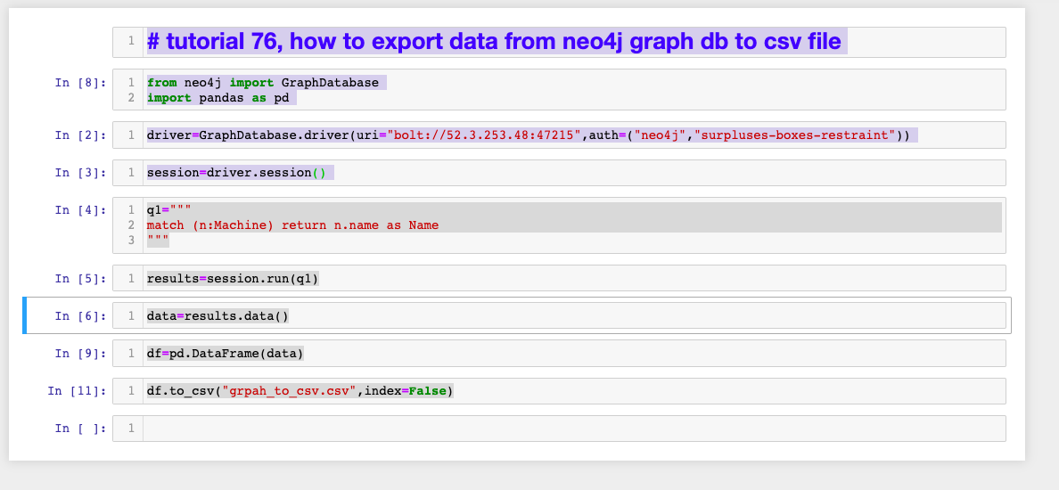
How to export Neo4j Graph Data Into Csv File
How to export Neo4j Graph Data Into Csv File

Slide 3
How to export Neo4j Graph Data Into Csv File
https://sandbox.neo4j.com/

